Slide 1
Email Signature for Staff
Visual Guide for iCON Users

Slide 2
Access iCON
Open your preferred internet browser and go to icon.moe.edu.sg
Log in with your userid and password
Click ‘Mail’

Slide 3

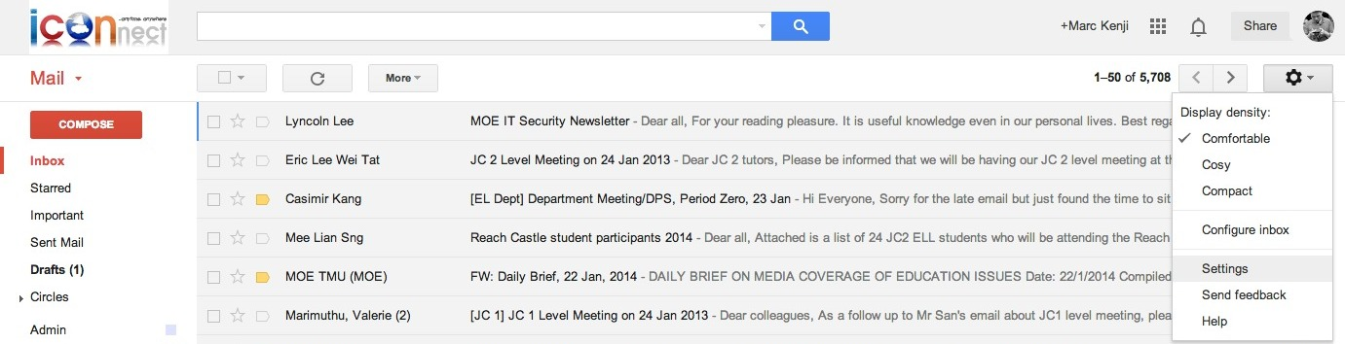
4. Click on the ‘Gear’ button
5. Click on ‘Settings’

Slide 4
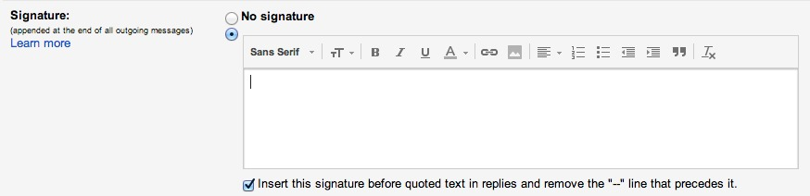
6. Scroll down until you see the ‘Signature’ section. Check the box next to ‘Insert this signature…’
To begin entering your signature, click the circular radio button below ‘No signature’.

Slide 5
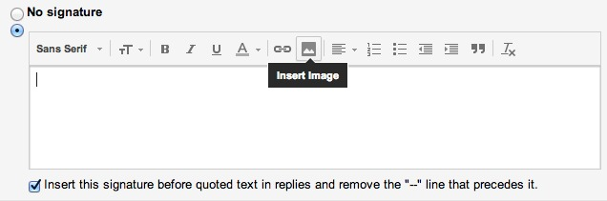
7. Next, we will insert the CJC crest. Click on the ‘Picture’ button to insert the image.

Slide 6
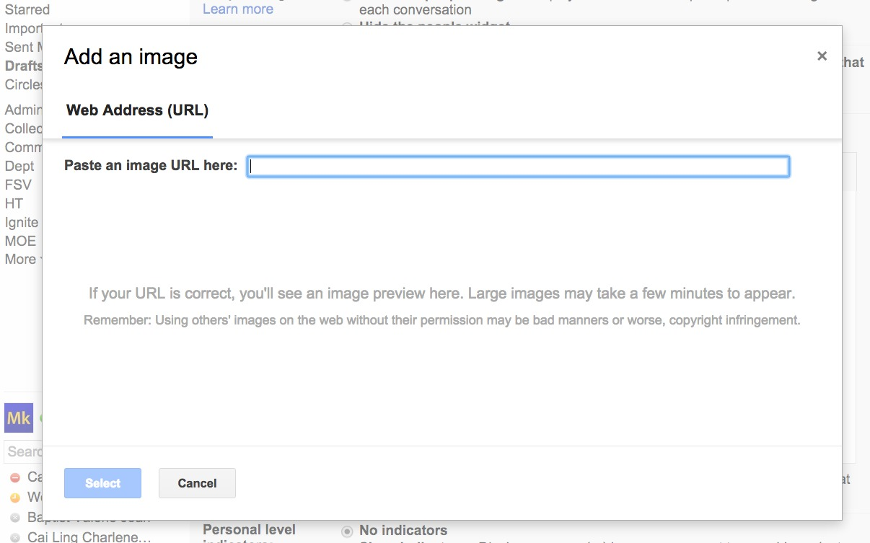
8. Paste the URL http://www.cjc.edu.sg/qql/slot/u495/Signature/crest.png into the address bar. You can do this by selecting URL, right-clicking to select ‘Copy’. Right click inside the box and click ‘Paste’. Click ‘Select’ to use the image.
Notes:
http://www.cjc.edu.sg/qql/slot/u495/Signature/crest.png

Slide 7
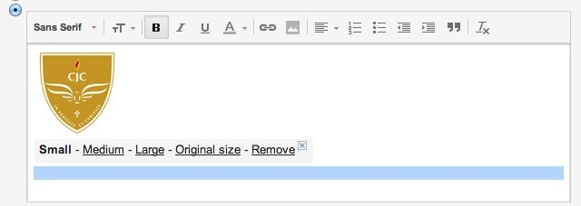
9. Click on the crest. Then click on ‘Small’.

Slide 8
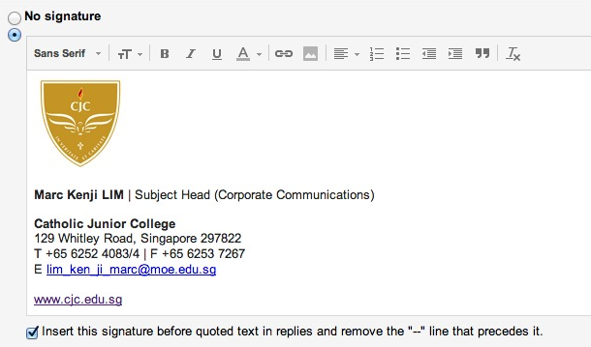
10. Press ‘Enter’ twice to leave a one line break from the crest. Type in your full name and appointment / teaching subject in the format below. Refer to the notes section for examples.
Notes:
First LAST | Teacher (Subject)
First LAST | Acting Subject Head (Subject)
First LAST | Subject Head (Subject)
First LAST | Level Head (Subject)
First LAST | Senior Teacher (Subject)
First LAST | Head of Department (Department)
First LAST | Acting Head of Department (Department)
First LAST | Year Head (JC_)
First LAST | Appointment (Details)

Slide 9
11. Press ‘Enter’ twice again to leave a one-line break. Next, copy and paste the college information from the notes section into the signature box. 12. Enter your email address.
Please leave a one-line break between ‘sections’
Notes:
Catholic Junior College
129 Whitley Road, Singapore 297822
T +65 6252 4083/4 | F +65 6253 7267
E youraddress@moe.edu.sg
www.cjc.edu.sg

Slide 10
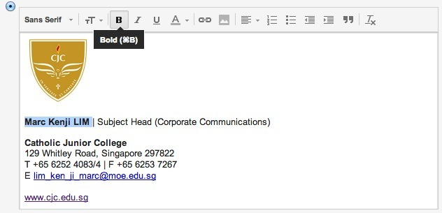
13. Set your full name and ‘Catholic Junior College’ in BOLD.

Slide 11
You’re almost there…
Scroll down and click ‘Save changes’.
That’s it! You should see your new email signature when you click ‘Compose’.

Slide 12

Notes:
CJC Back cover slide
CJC Cover slide (Option #2)
Note on usage: this is not to be used as a background slide. No text, photos or graphics should be placed on this slide.

